Slide 1
Presentation Script:
Top Techno IT Solutions
E-Commerce Website
Presented By: Emmanuela Obede
Reg:72314478
Course: BCA(CS)
Semester: 5
Agenda: We'll cover Who we are, Our Core Services, Our Portfolio, and How to Contact us
Presented To: Mr Prathvirasjsinghrathore

Slide 2
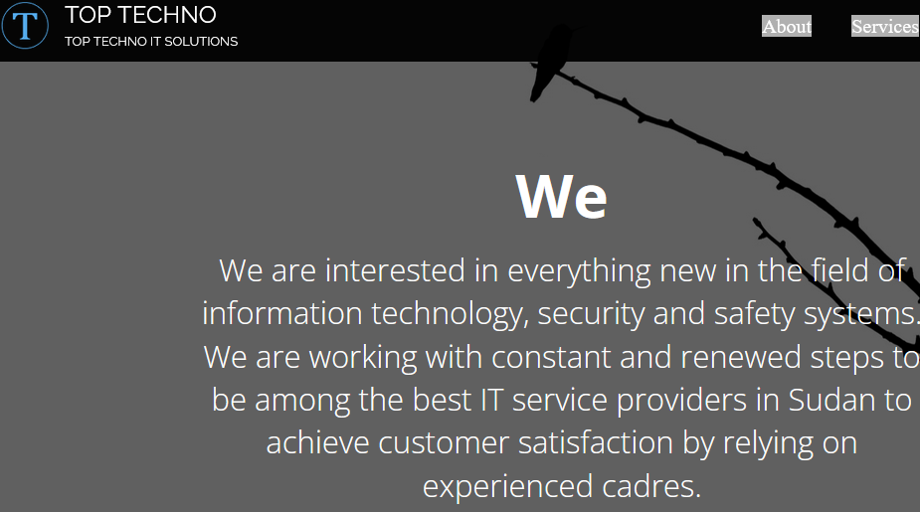
Introduction
Content:
Professional, modern, and clean website design.
The main banner immediately states our core mission.
Key Quote: "We are interested in everything new in IT, security, and safety systems."
Builds trust and credibility from the very first second.

Slide 3

Who We Are - Top Techno
Content:
IT solutions provider based in Sudan.
Goal: To be among the best IT service providers in the country.
Our Strength: Reliance on experienced cadres to achieve customer satisfaction.
Core Focus Areas:
  Fire Detection Devices
  Alarm Systems
  Attendance Tracking
  Network & Internet Services
  Computer Maintenance

Slide 4
Our Core Services
Content:
Early Fire Detection: Audible alarm systems for safe evacuation.
Alarm Systems: Electronic security for cars, offices, and homes against theft.
Computer Maintenance: Periodic maintenance and prompt repair services.
Clock In-Out Tracking: Modern fingerprint devices for attendance and access control.
Network & Internet Services: Secure communication infrastructure for businesses.

Slide 5
Our Portfolio
Content:
Interactive portfolio gallery.
Visitors can click on service images for more details.
Examples:
  CCTV: Complete surveillance systems for security.
  Network Installation: Building smart, integrated networks.
  Fire Alarms: Manual and automated detection systems.
Engaging and informative for potential clients.

Slide 6
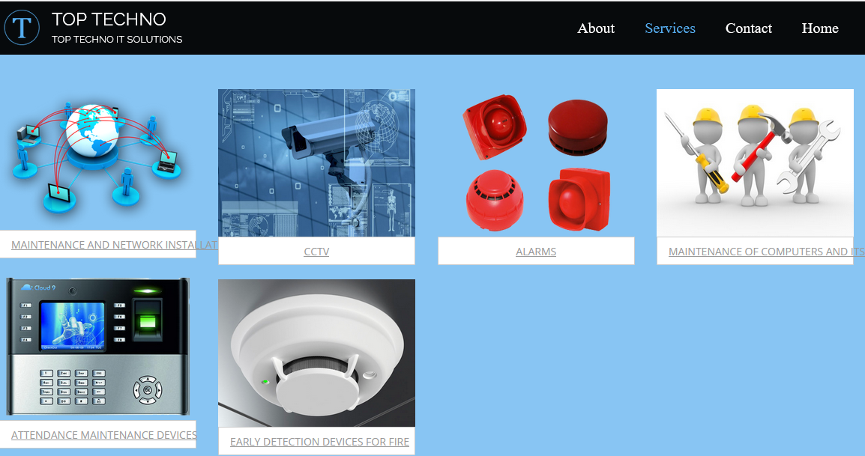
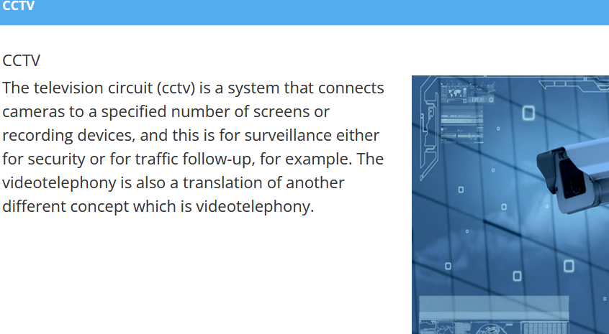
Our Portfolio

Slide 7
How to Reach Us
Contact Details:
Location: Juba
Phone: +211 994514139
Phone: +211 918645705
Phone: +211 922168992
Email: emmanuelaobede@gmail.com
Connect With Us:
Facebook, Twitter, Google+
Skype, LinkedIn, YouTube
Flickr, Pinterest
Easy to follow our updates.

Slide 8
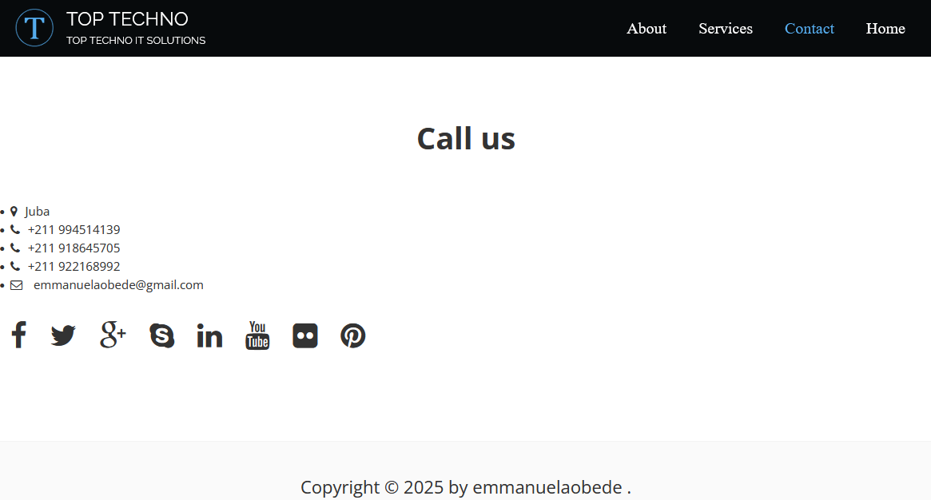

Slide 9
Website Design & User Experience
Content:
Responsive Design: Works perfectly on desktop, tablet, and mobile.
Professional Look: Trustworthy color scheme (blues/whites) and modern typography.
Easy Navigation:
  Fixed menu at the top.
  Jump to any section (Home, About, Services, Contact) instantly.
The website itself demonstrates our technical skill.

Slide 10
Conclusion
Top Techno is your professional, reliable, and comprehensive partner for IT and security.
The website is designed to clearly communicate our value and convert visitors into clients.
Final Call to Action:
  Call: +211 994514139
  Email: emmanuelaobede@gmail.com

Slide 11
THANK YOU!

